Slide 1


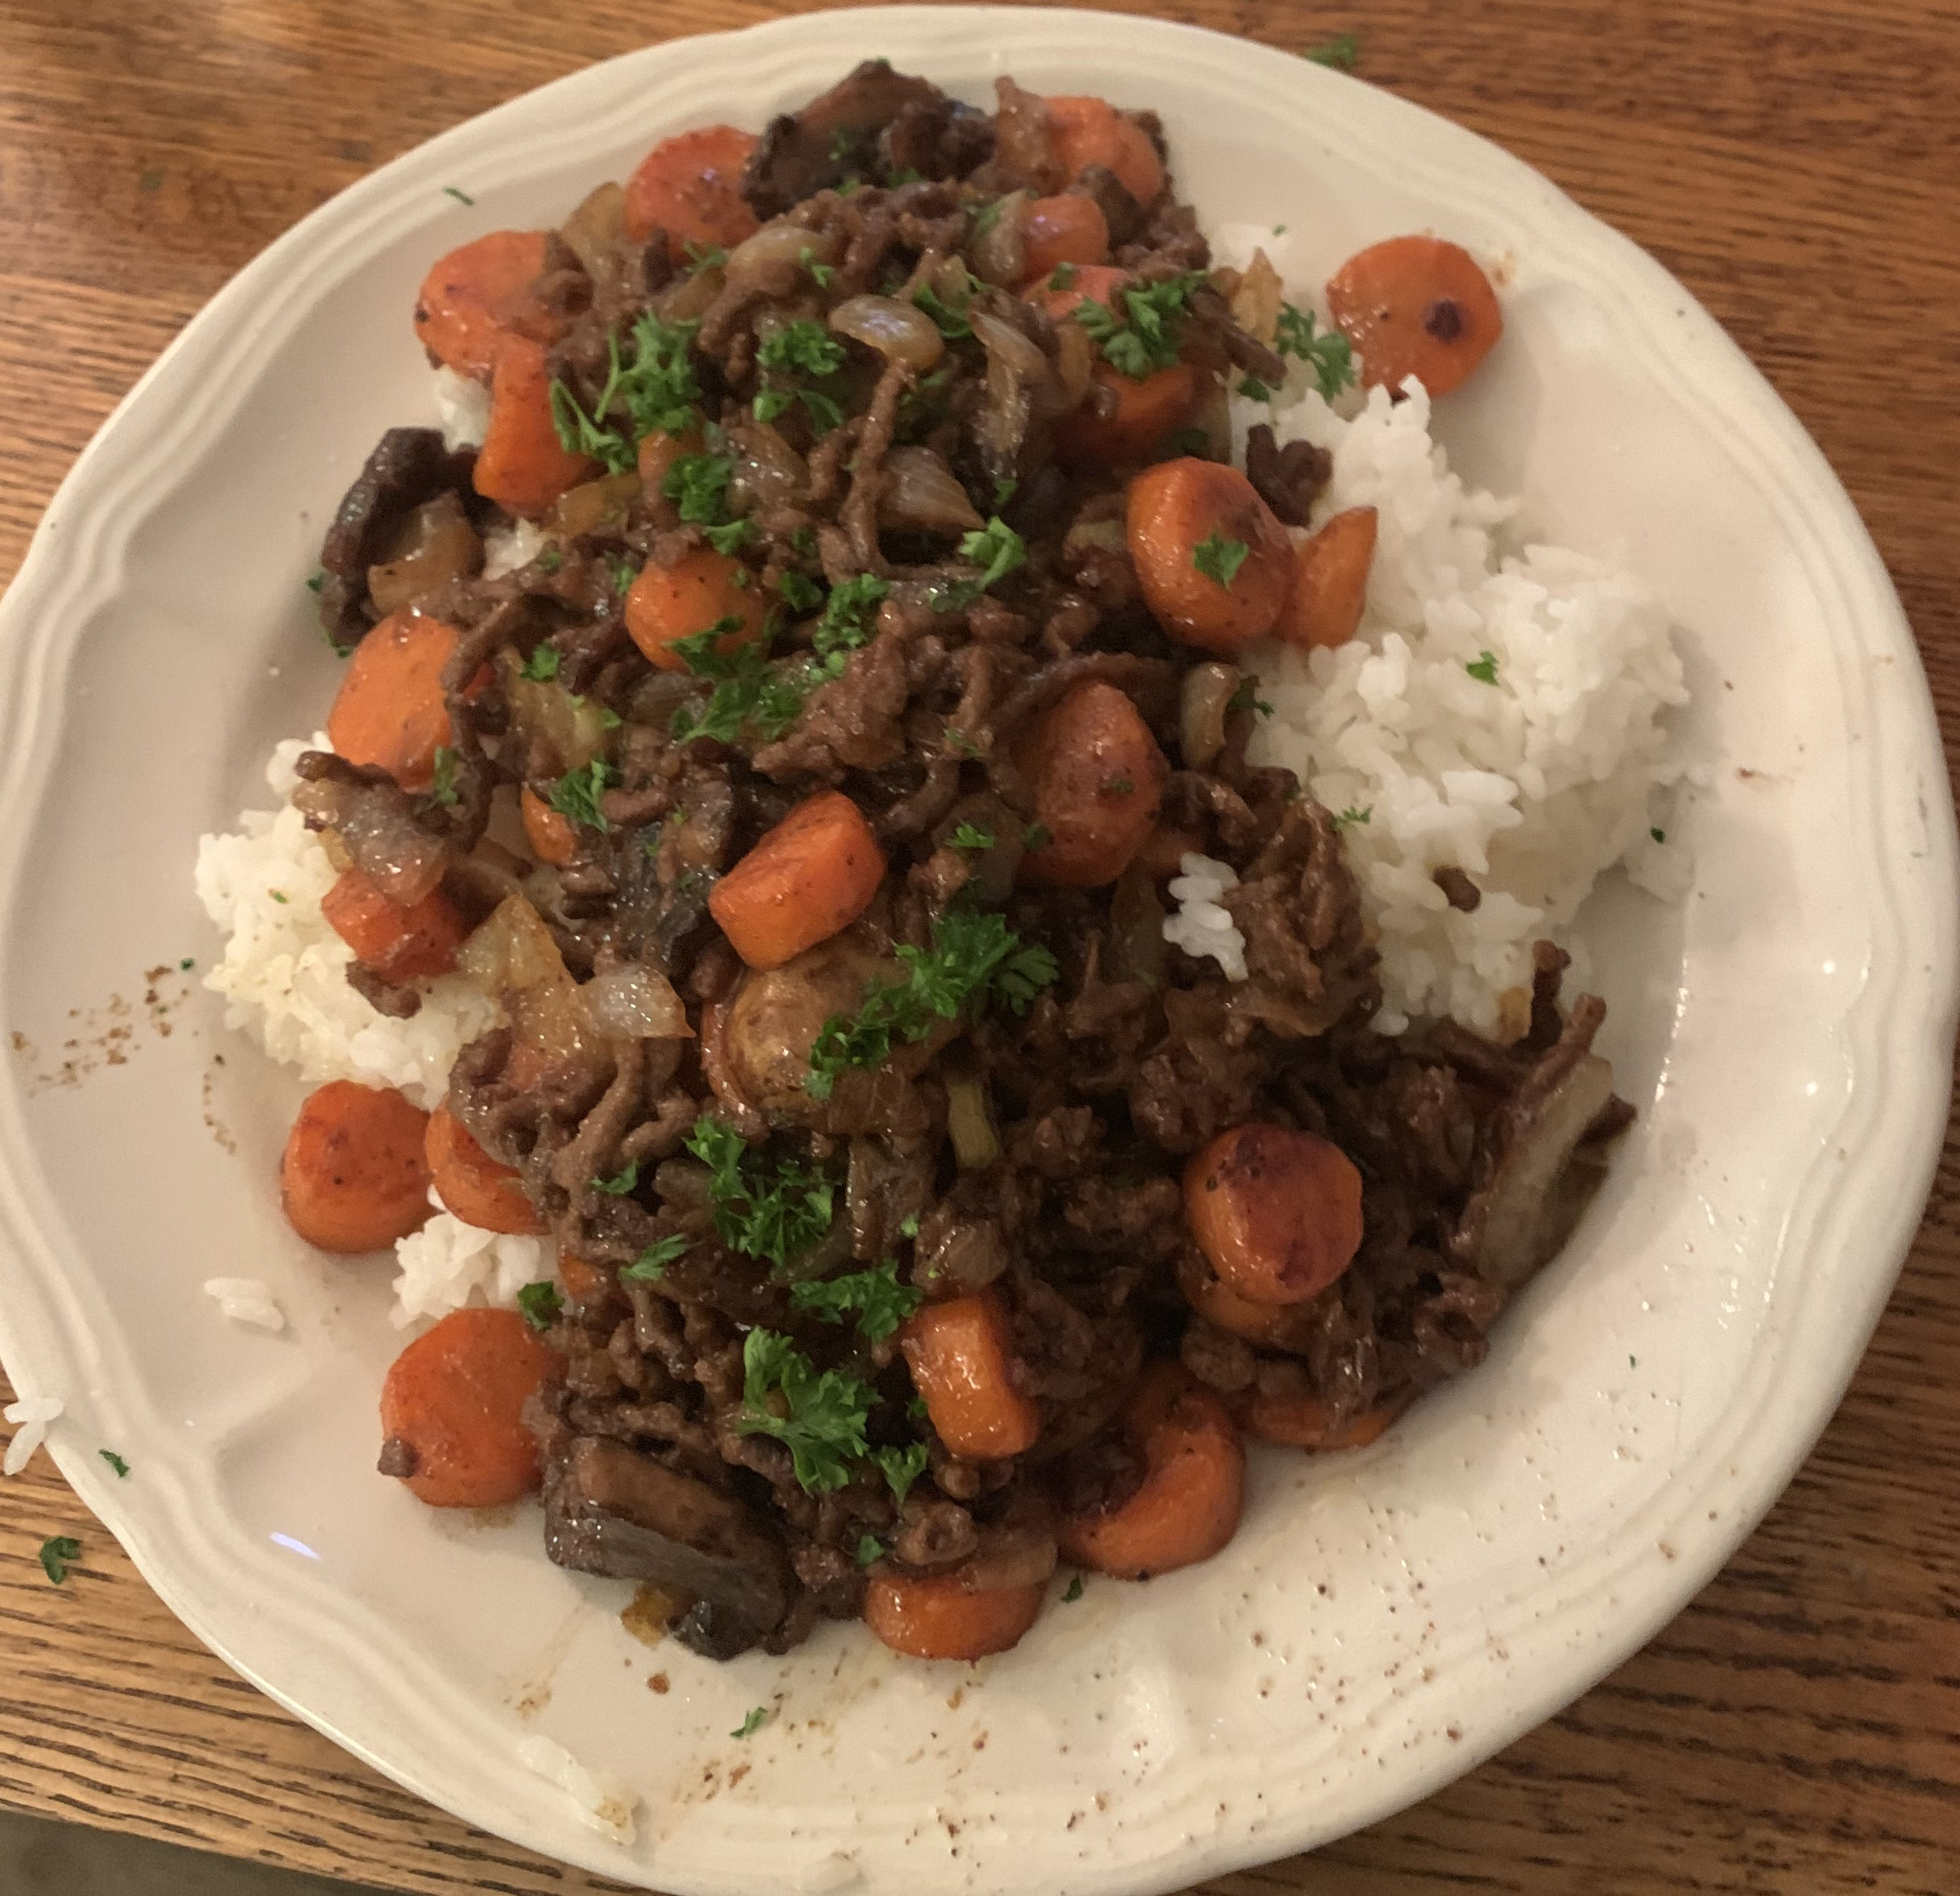
PANDEMONIUM

Slide 2
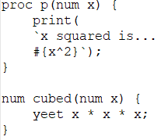
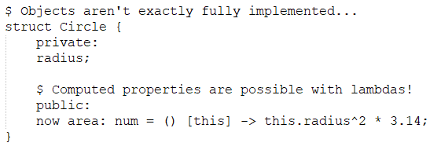

FEATURES
Procedures vs. Functions
Classes & Structs… sort of
2 element for loops
(also lambdas!)

Slide 3
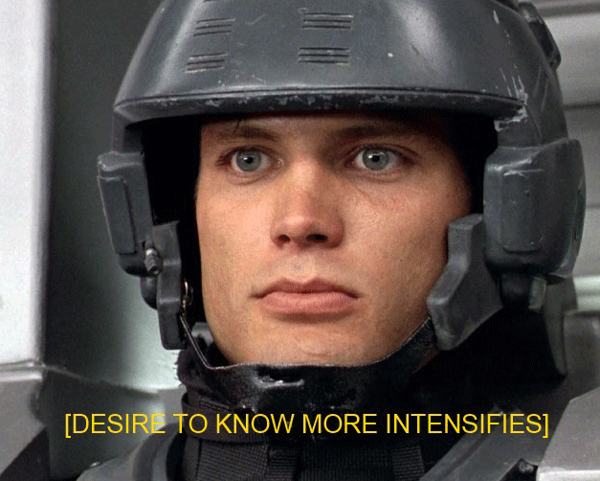

WOULD YOU LIKE TO KNOW MORE?

